Slide 1

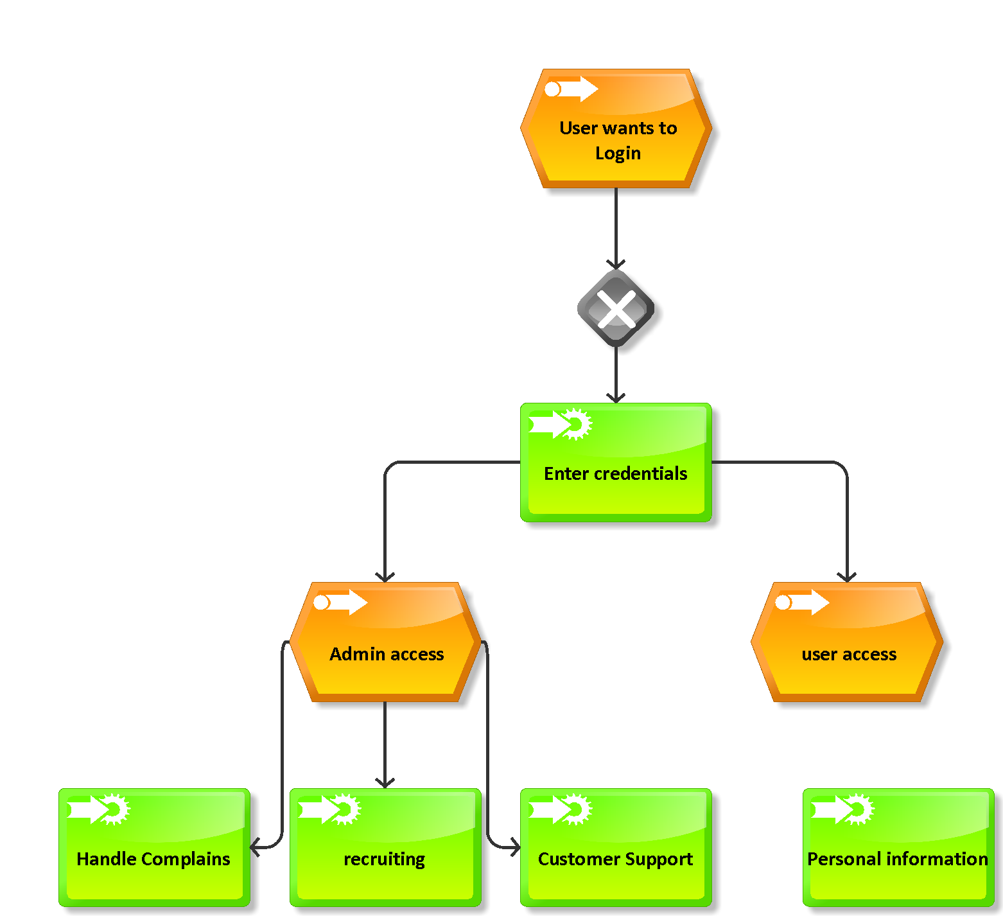
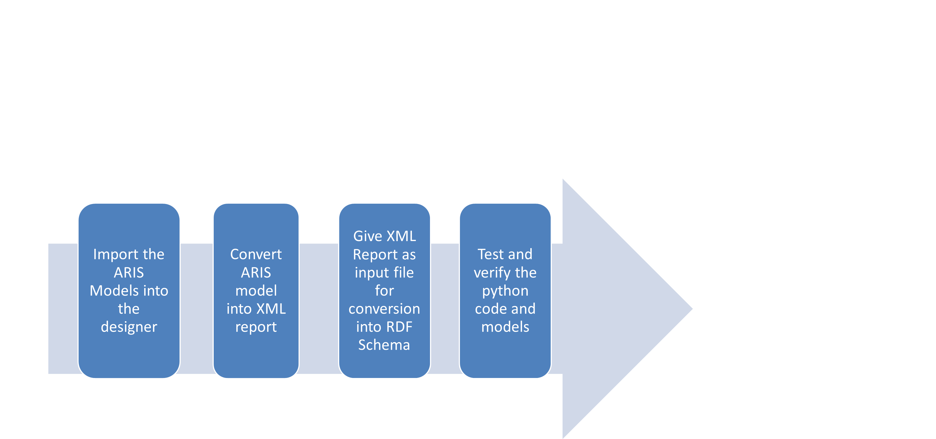
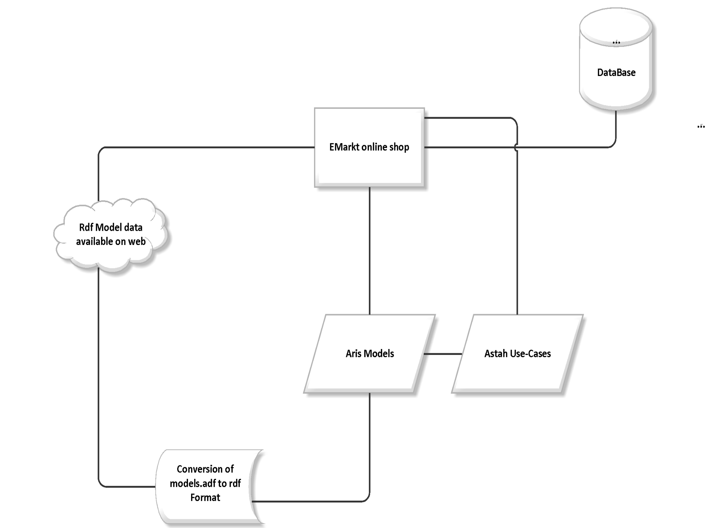



Logo/Icon
Modeling the Structure & Processes of an online-shop
Set-Up and Showcase an E-Commerce system using ARIS 9.6/Express
goto:
Naurin Jamil
Dmytro Iarovyi
https://github.com/EIS-Bonn/MA-INF3232-Lab/tree/master/SomSem2014/Group%20K%20(ModellingEIS_Orlandi)
WHY ?
Consider an online shop “E-Markt”
The system analyzes different processes in the e-shop
Identifies the different use cases to cover functionalities
Builds corresponding Aris models to understand business processes
XML reports are generated from the model to give generic data
Builds RDF schema for the XML files for model data extension to re-use model data
WHAT?
Analyzed the use-cases as created in UML Designing tool ASTAH
Analyzed the ARIS Event Process Chain(EPC) Diagrams
For the EPC Diagrams, XML reports were generated
The ARIS diagrams were tested using ARIS Express testing tool
Generated RDF Files for XML reports of models
Tested the RDF file against simple Unit tests for Python
HOW ?
Open the Virtual machine
The ARIS Models are located in: ~/Dev/BMP
The identified Use-Cases are located in: ~/dev/USE_Cases
The script for model conversion into XML format already included in ARIS setup: exportToXML
The XML to RDF conversion script can be executed as: python converter.py [name of XML file]
The python code can be tested using unit tests : python unit_tests.py
Example :Log-In Event Process Chain Diagram
Steps to work :
ARCHITECTURE Diagram ‘E-Markt’
<Virtual Machine Description>
Hostname: EISGroupK
Software installed:
Installed on: EIS2
Python 3.4(RDFLib, Unittest libraries)
Aris Architect & Design 9.6
Local Access:
OS User: EIS02/eis-lab
Password: E1sPa33w0rd
Remote Access:
Partner ID: 288 967 668
Password: q2rp84
Help-Lines :
www.ariscommunity.com
EIS
Enterprise
Information Systems
Enterprise
Information Systems

